Slide 1
Machine Learning 101

Slide 2
Notes:
The McGill initiative on Computational Medicine was formed in 2017 and aims to deliver inter-disciplinary research programs and empower the use of data in health research and health care delivery
Located at the Genome Center
They have a newsletter were you can subscribe to
more info on the web site

Slide 4
Workshop agenda
Machine Learning (ML) introduction
ML models, tasks, and important concepts
Decision Trees (DTs)
Artificial Neural Networks (ANNs)
Coding Competition
Next steps
Q&A

Slide 5

Terminologies
Artificial Intelligence (AI)
Broader science (domain) of incorporating human intelligence to machines
Machine Learning (ML)
Subset of AI, provides computer ability to learn and improve from experience
Many algorithms: Artificial Neural Networks (ANNs), Support Vector Machines (SVM), Decision Trees (DTs) , …
Deep Learning (DL)
Evolution of ML
Advanced models of ANN
Extracting and finding features
Data Science
Umbrella term for the above
Widely used in industry
Includes data mining
https://blogs.nvidia.com/blog/2016/07/29/whats-difference-artificial-intelligence-machine-learning-deep-learning-ai/

Slide 6
ML definitions
Technical definition
“A computer program is said to learn from experience E with respect to some class of tasks T and performance measure P, if its performance at tasks in T, as measured by P, improves with experience E” - Tom Mitchel
Less formal
“Computer systems that automatically improve with experience”

Slide 7
ML broad tasks
Classification
Output: Binary or multiple classes
E.g., images classification, cancer detection, email spams
Regression
Output: Continuous or discrete
E.g., weather forecasting, stock price prediction
Clustering
Partitioning data into regions
Not an exhaustive list

Slide 8
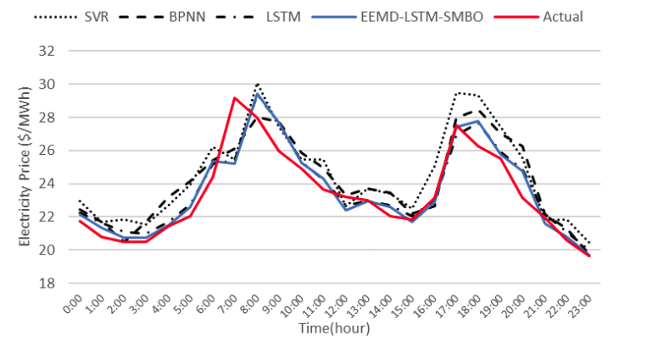
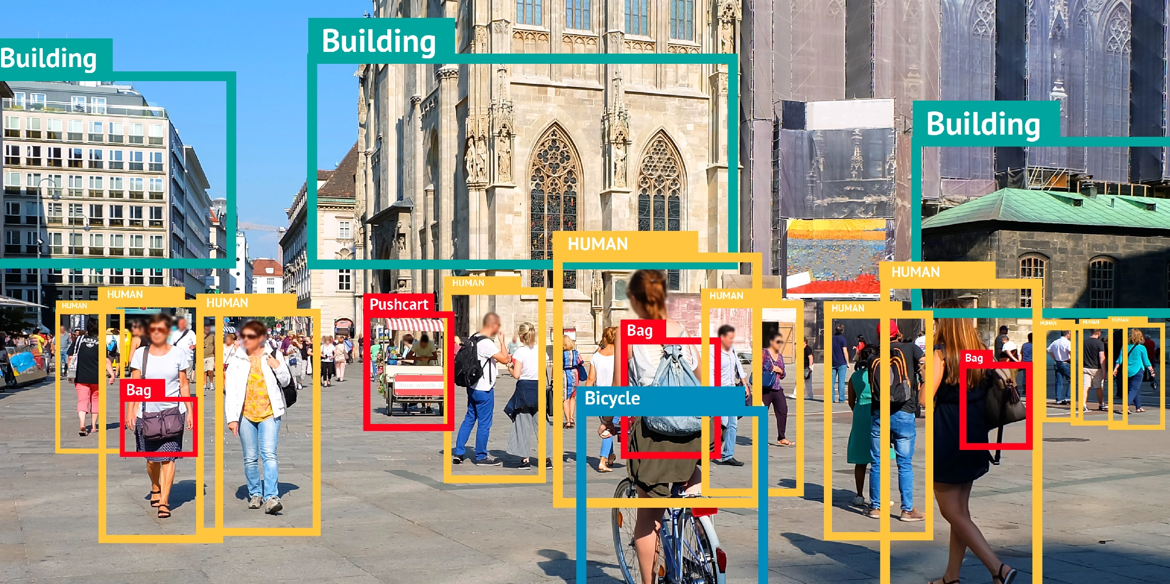
ML models
Supervised learning
We have labeled data
Classification, regression, ranking
Zhou et al. “An Optimized heterogeneous structure LSTM Network for Price Forecasting”, 2019.
https://bitmovin.com/object-detection/

Slide 9
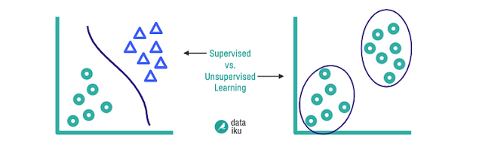
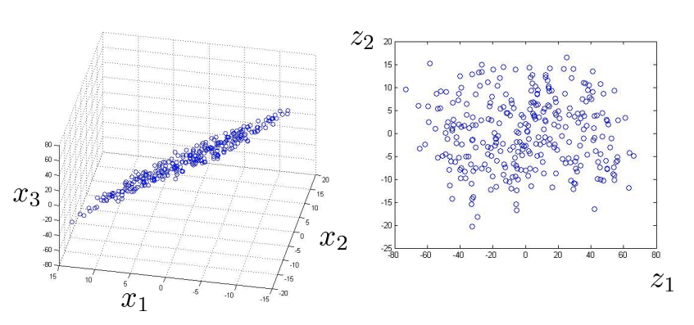
ML models
Unsupervised learning
We don’t provide labels
Clustering, dimensionality reduction
https://blog.dataiku.com/clustering-how-it-works-in-plain-english

Slide 10
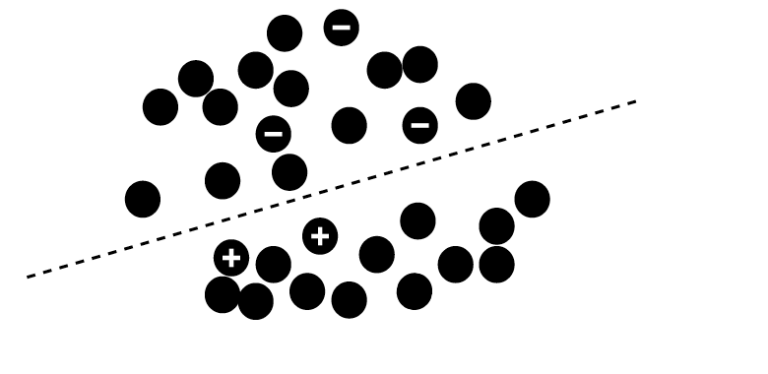
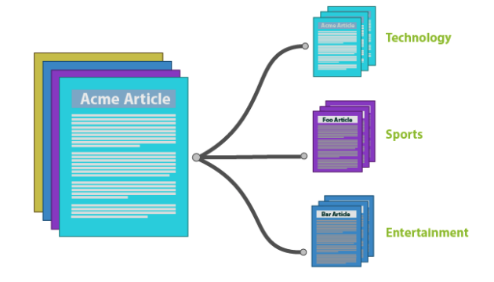
ML models
Semi-supervised learning
Only a subset of data is labeled
https://github.com/javedsha/text-classification

Slide 11
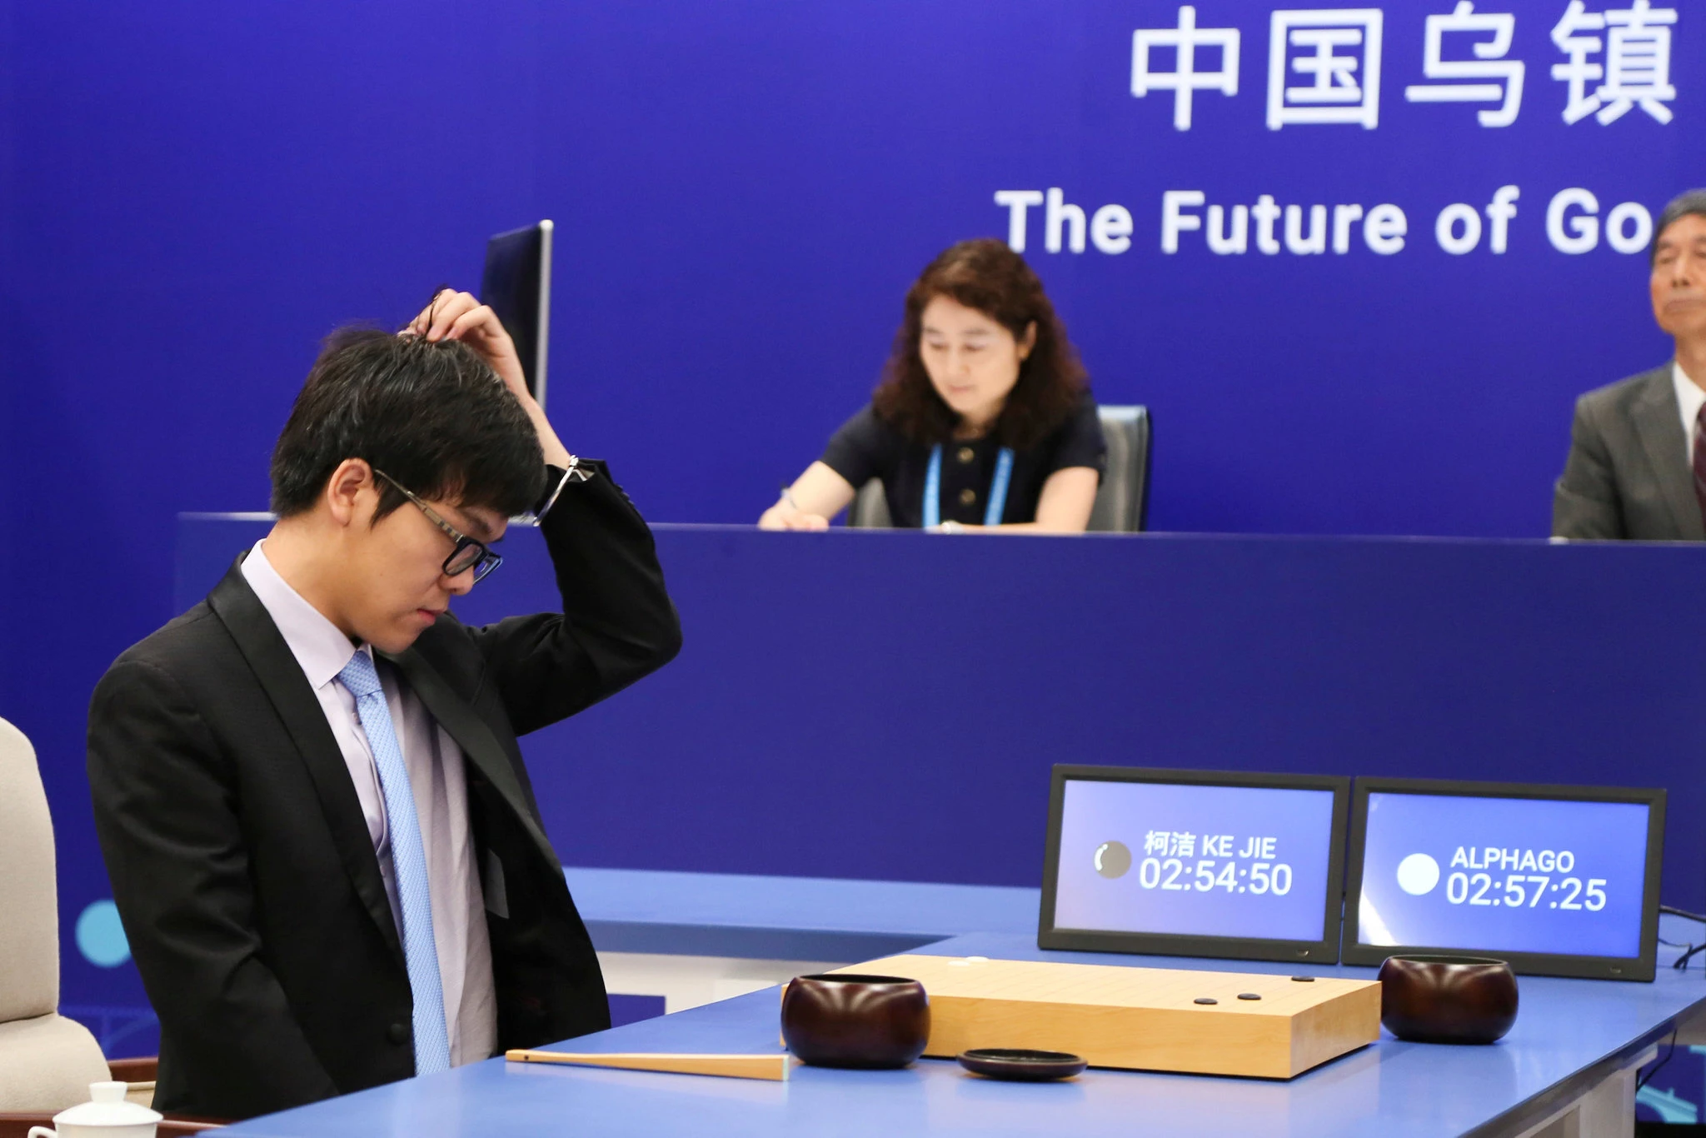
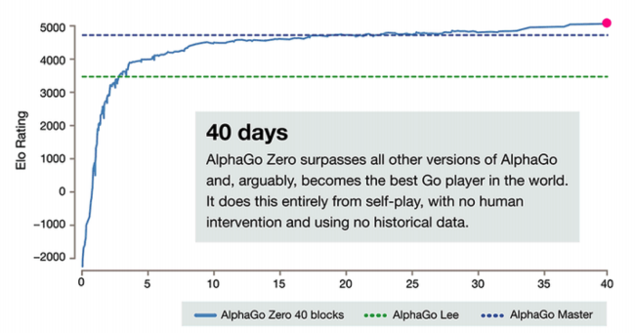
ML models
Unsupervised learning
Reinforcement learning
Agent that gets explores an environment and gets rewards
Ke Jie, the world’s top Go player, reacting during his match on Tuesday against AlphaGo, artificial intelligence software developed by a Google affiliate. Credit...China Stringer Network, via Reuters. May 23, 2017
https://deepmind.com/blog/article/alphago-zero-starting-scratch

Slide 12
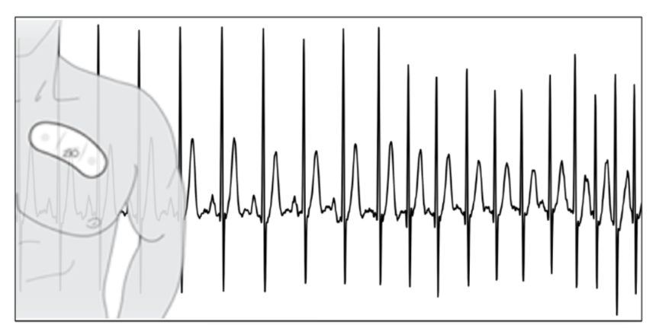
ML applications
Theoretical vs Applied ML
Importance of domain knowledge
Data preprocessing
Results interpretation
ECG data: Rajpurkar et al., 2017

Slide 13
ML main concepts
Learning = Representation + Evaluation + Optimization
Representation: Features Space
Evaluation: Objective function
Measure how good the model is
Error between prediction and actual target
Optimization: Improve and minimize the error
Adjust model parameters to decrease error
Repeat until convergence

Slide 14
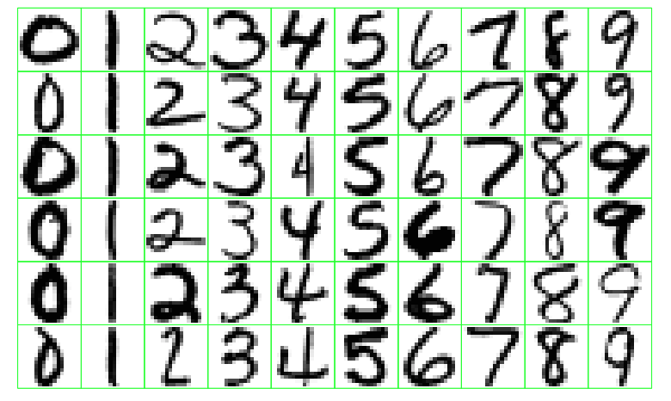
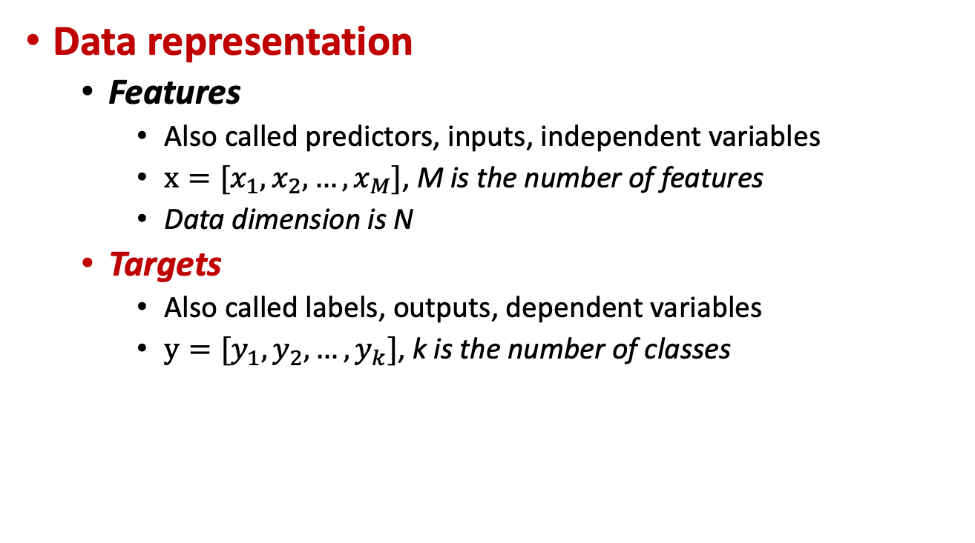
ML main concepts
Data representation
Features
Also called predictors, inputs, independent variables
$x=[x_{1}, x_{2}, …, x_{M}]$, M is the number of features
Data dimension is N
Targets
Also called labels, outputs, dependent variables
$y=[y_{1}, y_{2}, …, y_{k}]$, k is the number of classes
Classes
N Samples

Slide 15
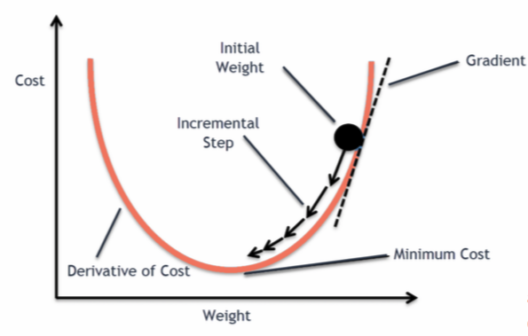
ML main concepts
Optimization: Minimize an objective function
What is a learning algorithm?
Iterative approach
E.g., Gradient descent
https://blog.clairvoyantsoft.com/the-ascent-of-gradient-descent-23356390836f

Slide 16
ML main concepts
Building a model
Objective definition
Data preparation
Model selection
1
Training
Evaluation
Parameters tuning
2
3
Inference
Final model

Slide 17
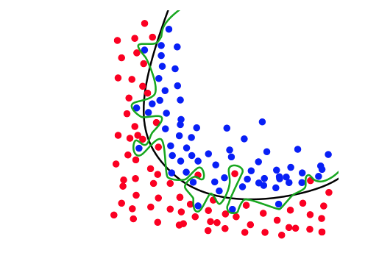
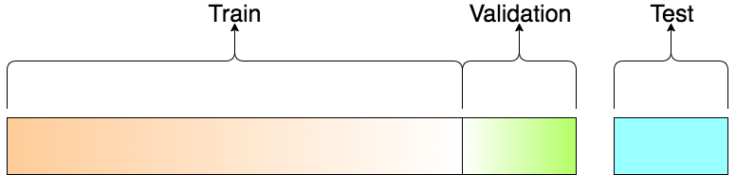
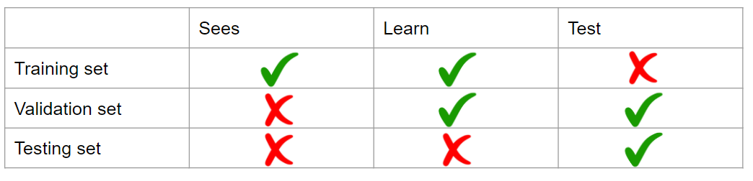
ML main concepts
Data split into training and testing sets
Avoids overfitting
Important for generalization in the real world
Cross validation
https://elitedatascience.com/overfitting-in-machine-learning

Slide 18
Decision Trees (DTs)
Main idea: Divide space into regions using a tree structure
Classification tasks: class label
Regression tasks: real scalar
Build the DT based on the value of a single variable

Slide 19
DTs motivation
Handling of categorical variables.
Handling of missing values and unknown values.
Detection of non-linear relationships.
Visualization and interpretation in decision trees.

Slide 20
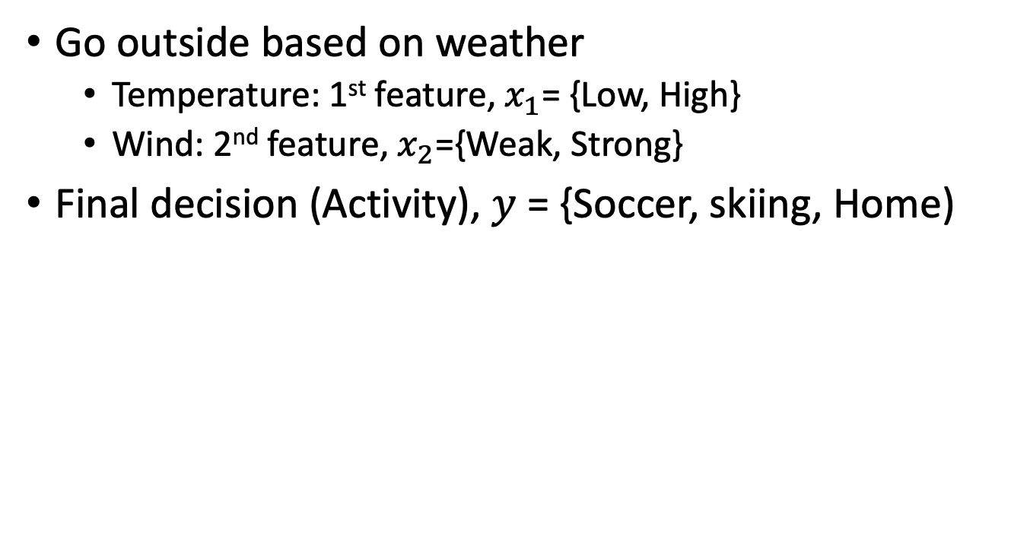
DTs main idea
Go outside based on weather
Temperature: 1st feature, $x_{1}$= {Low, High}
Wind: 2nd feature, $x_{2}$={Weak, Strong}
Final decision (Activity), $y$ = {Soccer, skiing, Home)
Low Temperature?
Strong wind?
Play soccer
Stay home
Strong wind?
Go skiing
Stay home
No
Yes

Slide 21
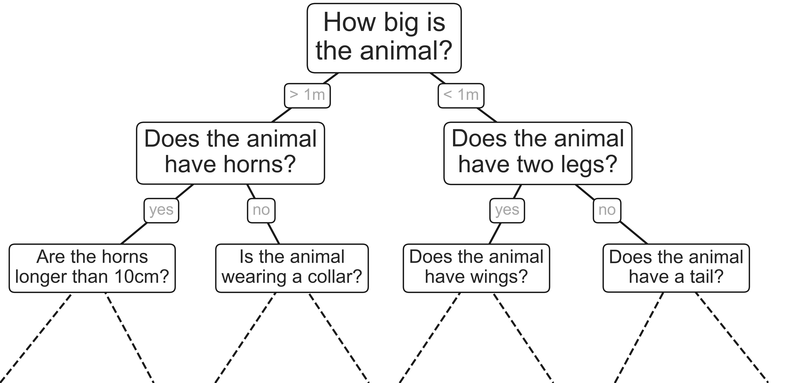
DTs motivation
Intuitive way to classify objects
Series of questions
Example: classify animals based on criteria

Slide 22
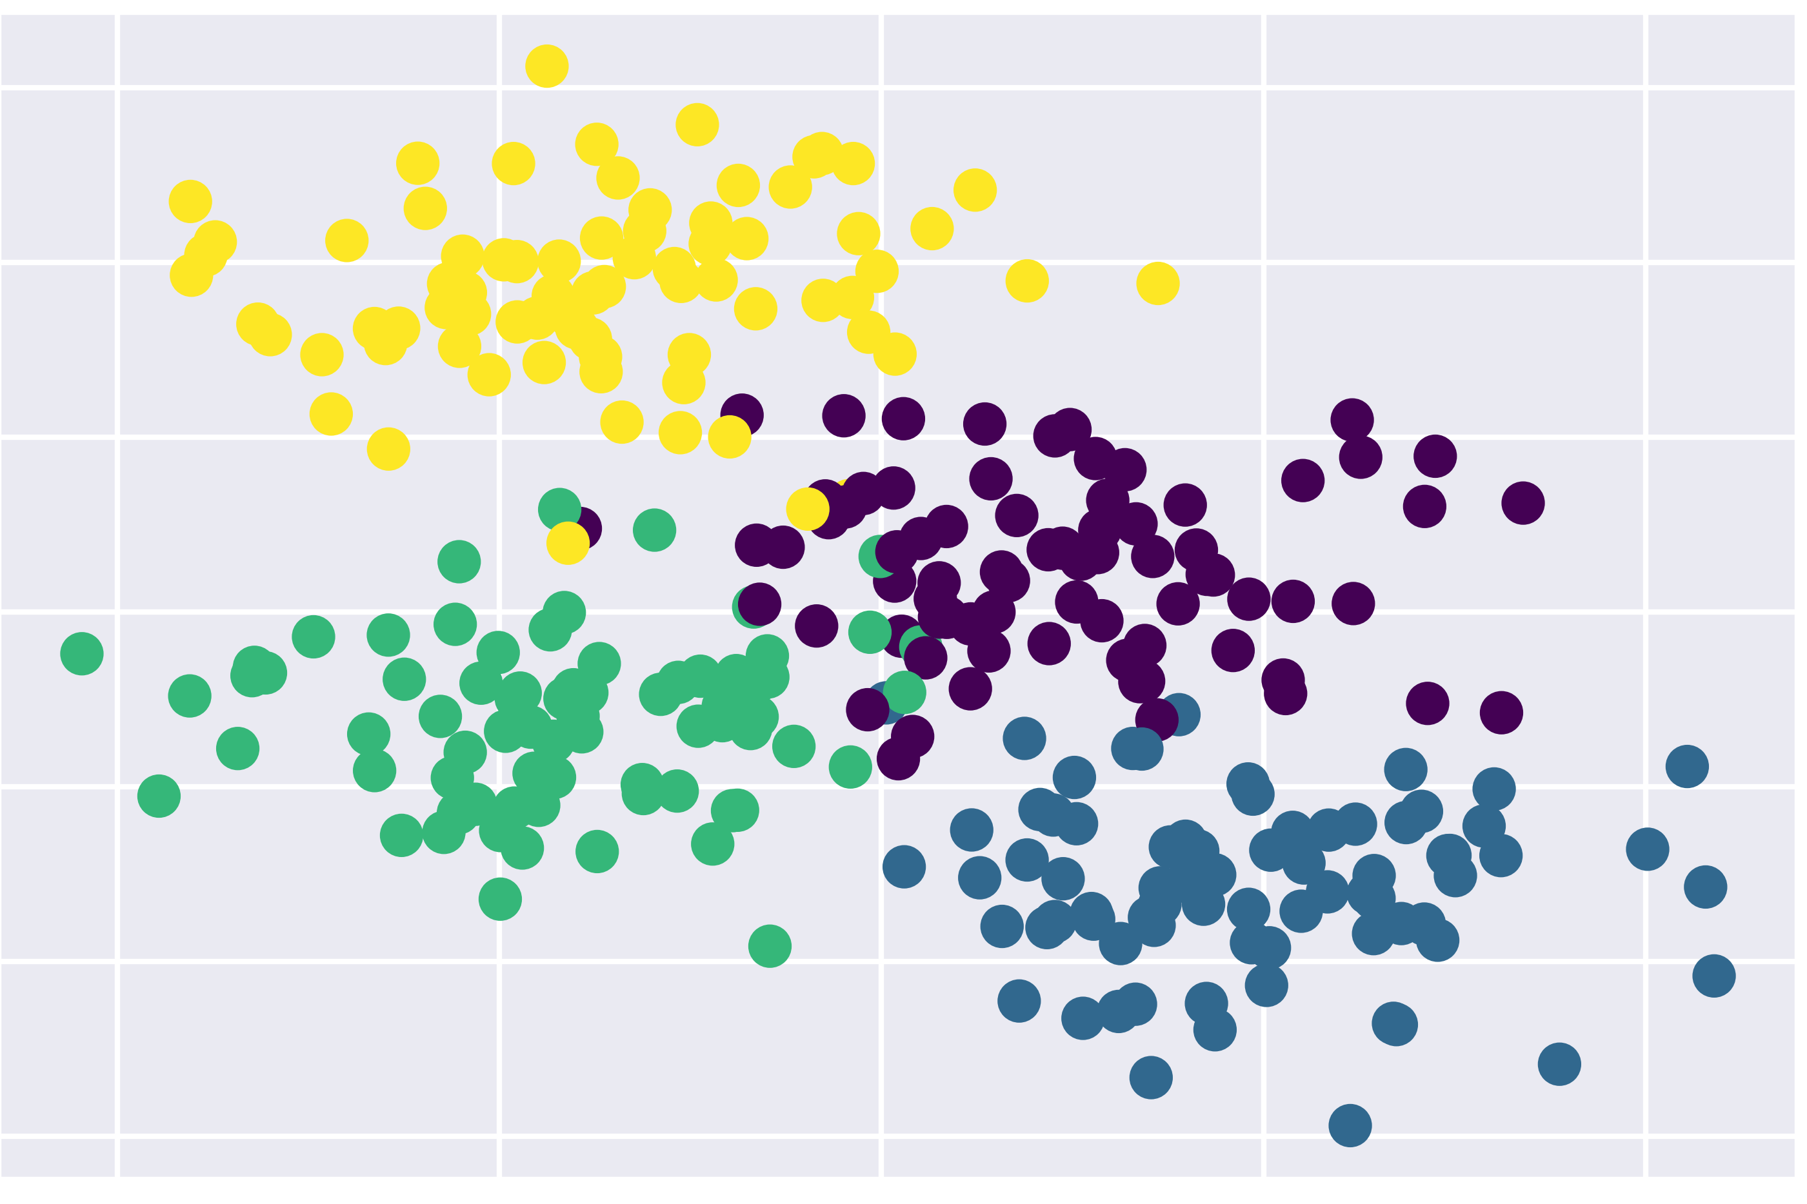
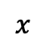
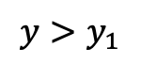
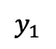
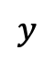
DTs example
$$y>y_{1}$$
$$y$$
$$y_{1}$$
$$x$$

Slide 23
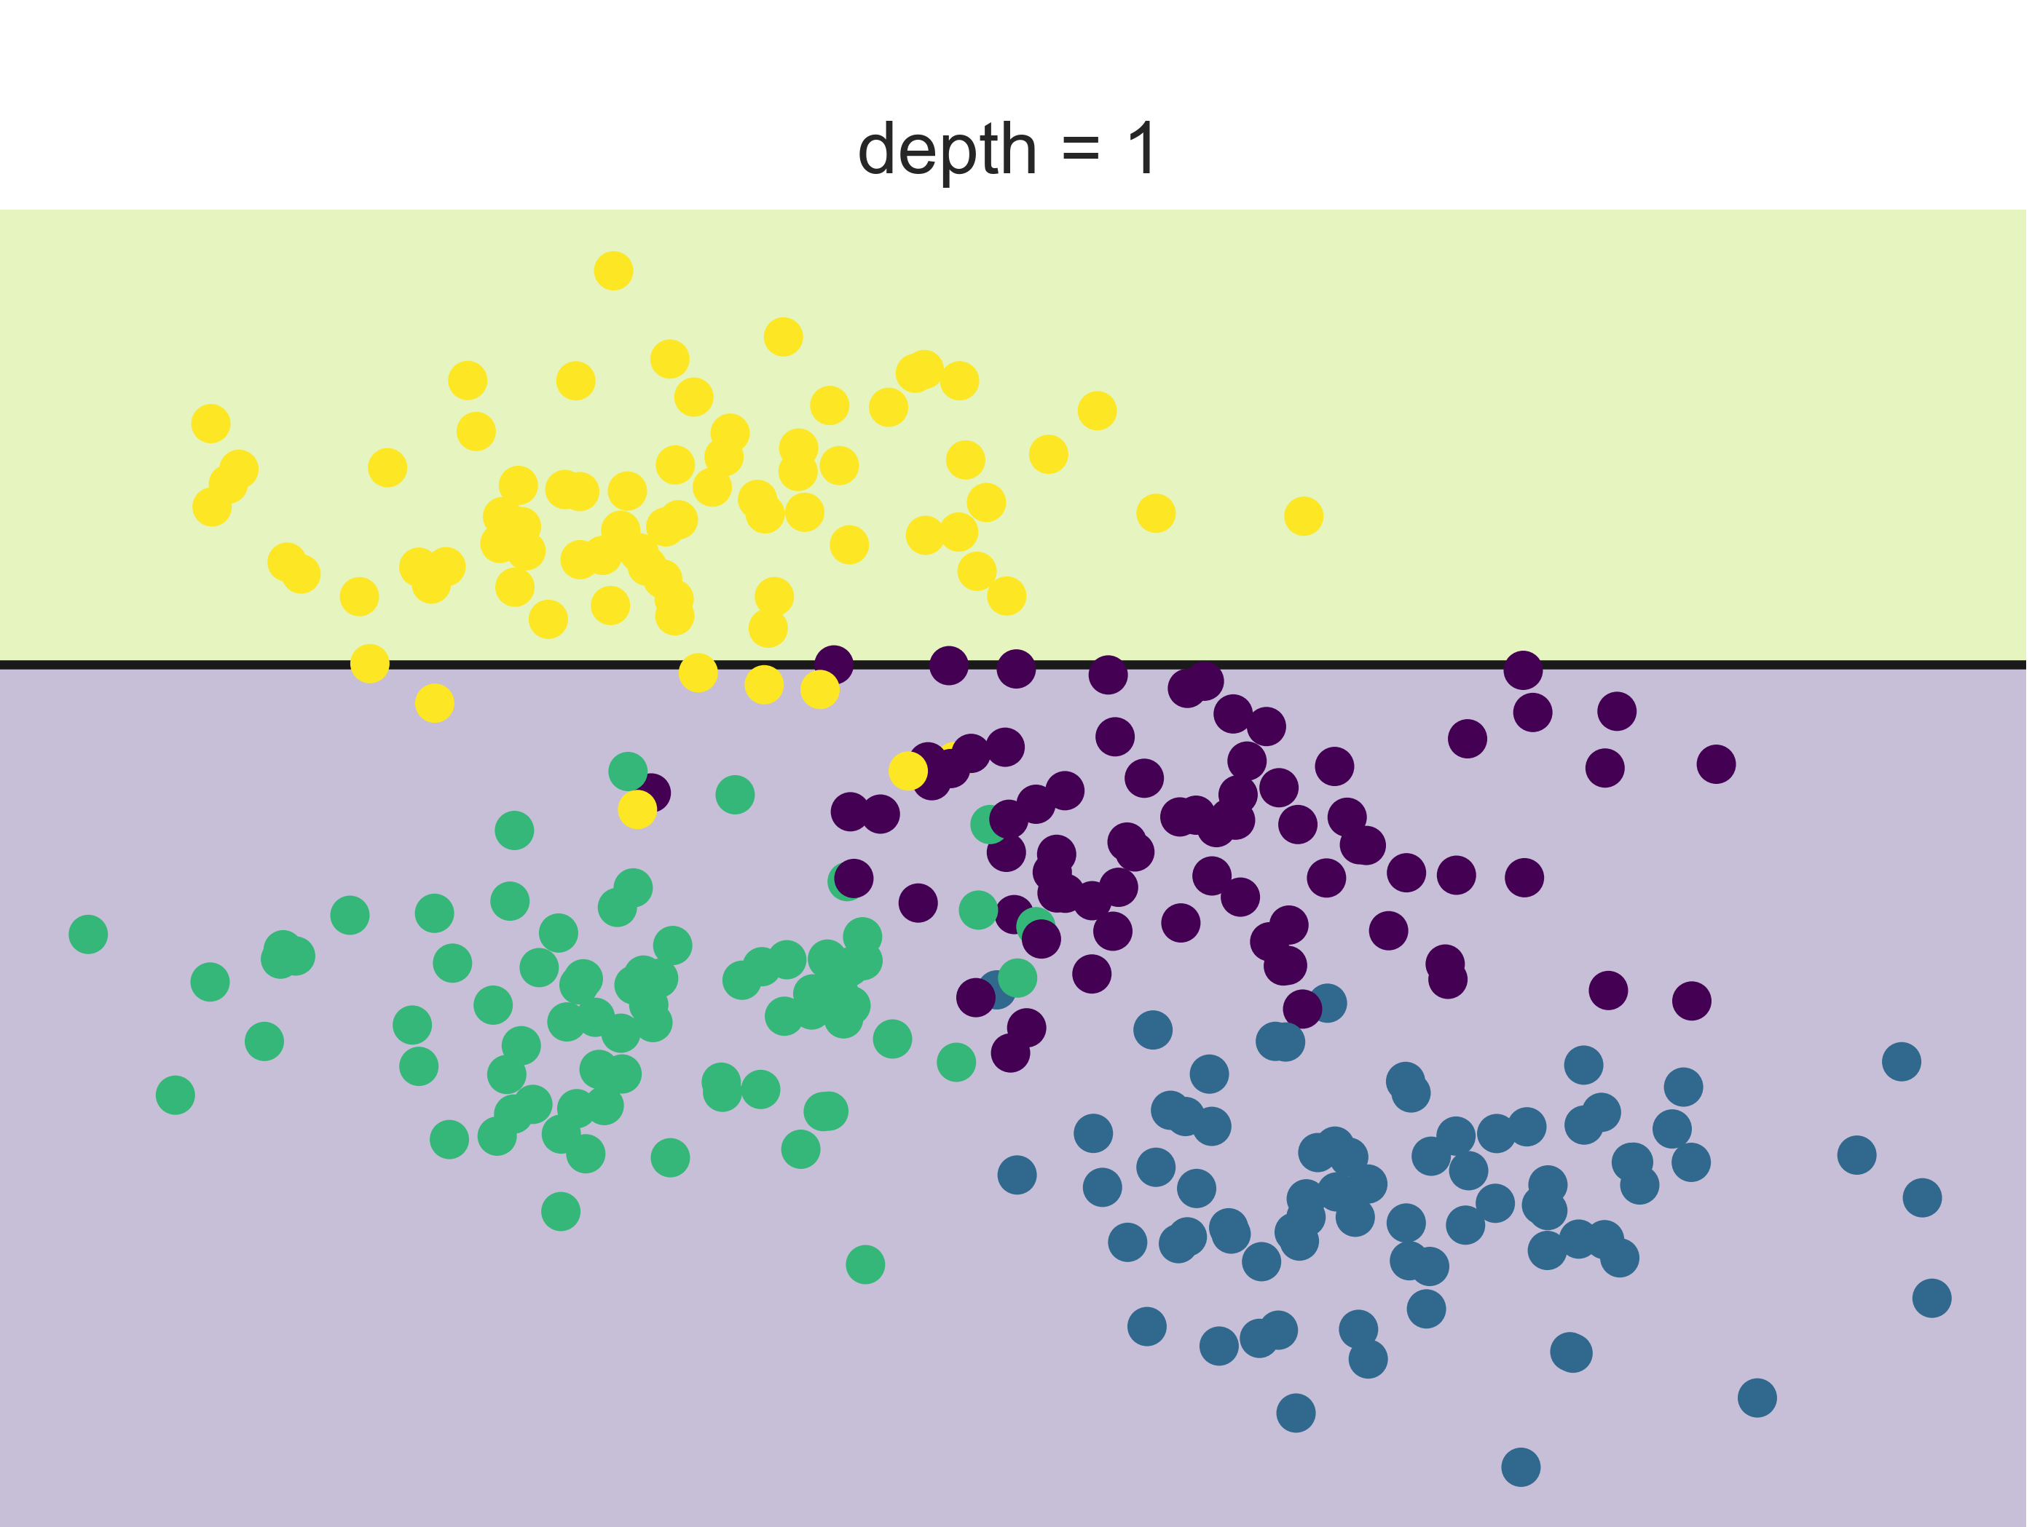
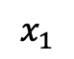
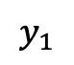
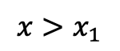
DTs example
$$y>y_{1}$$
$$x>x_{1}$$
$$y$$
yellow
$$y_{1}$$
$$x_{1}$$
$$x$$

Slide 24
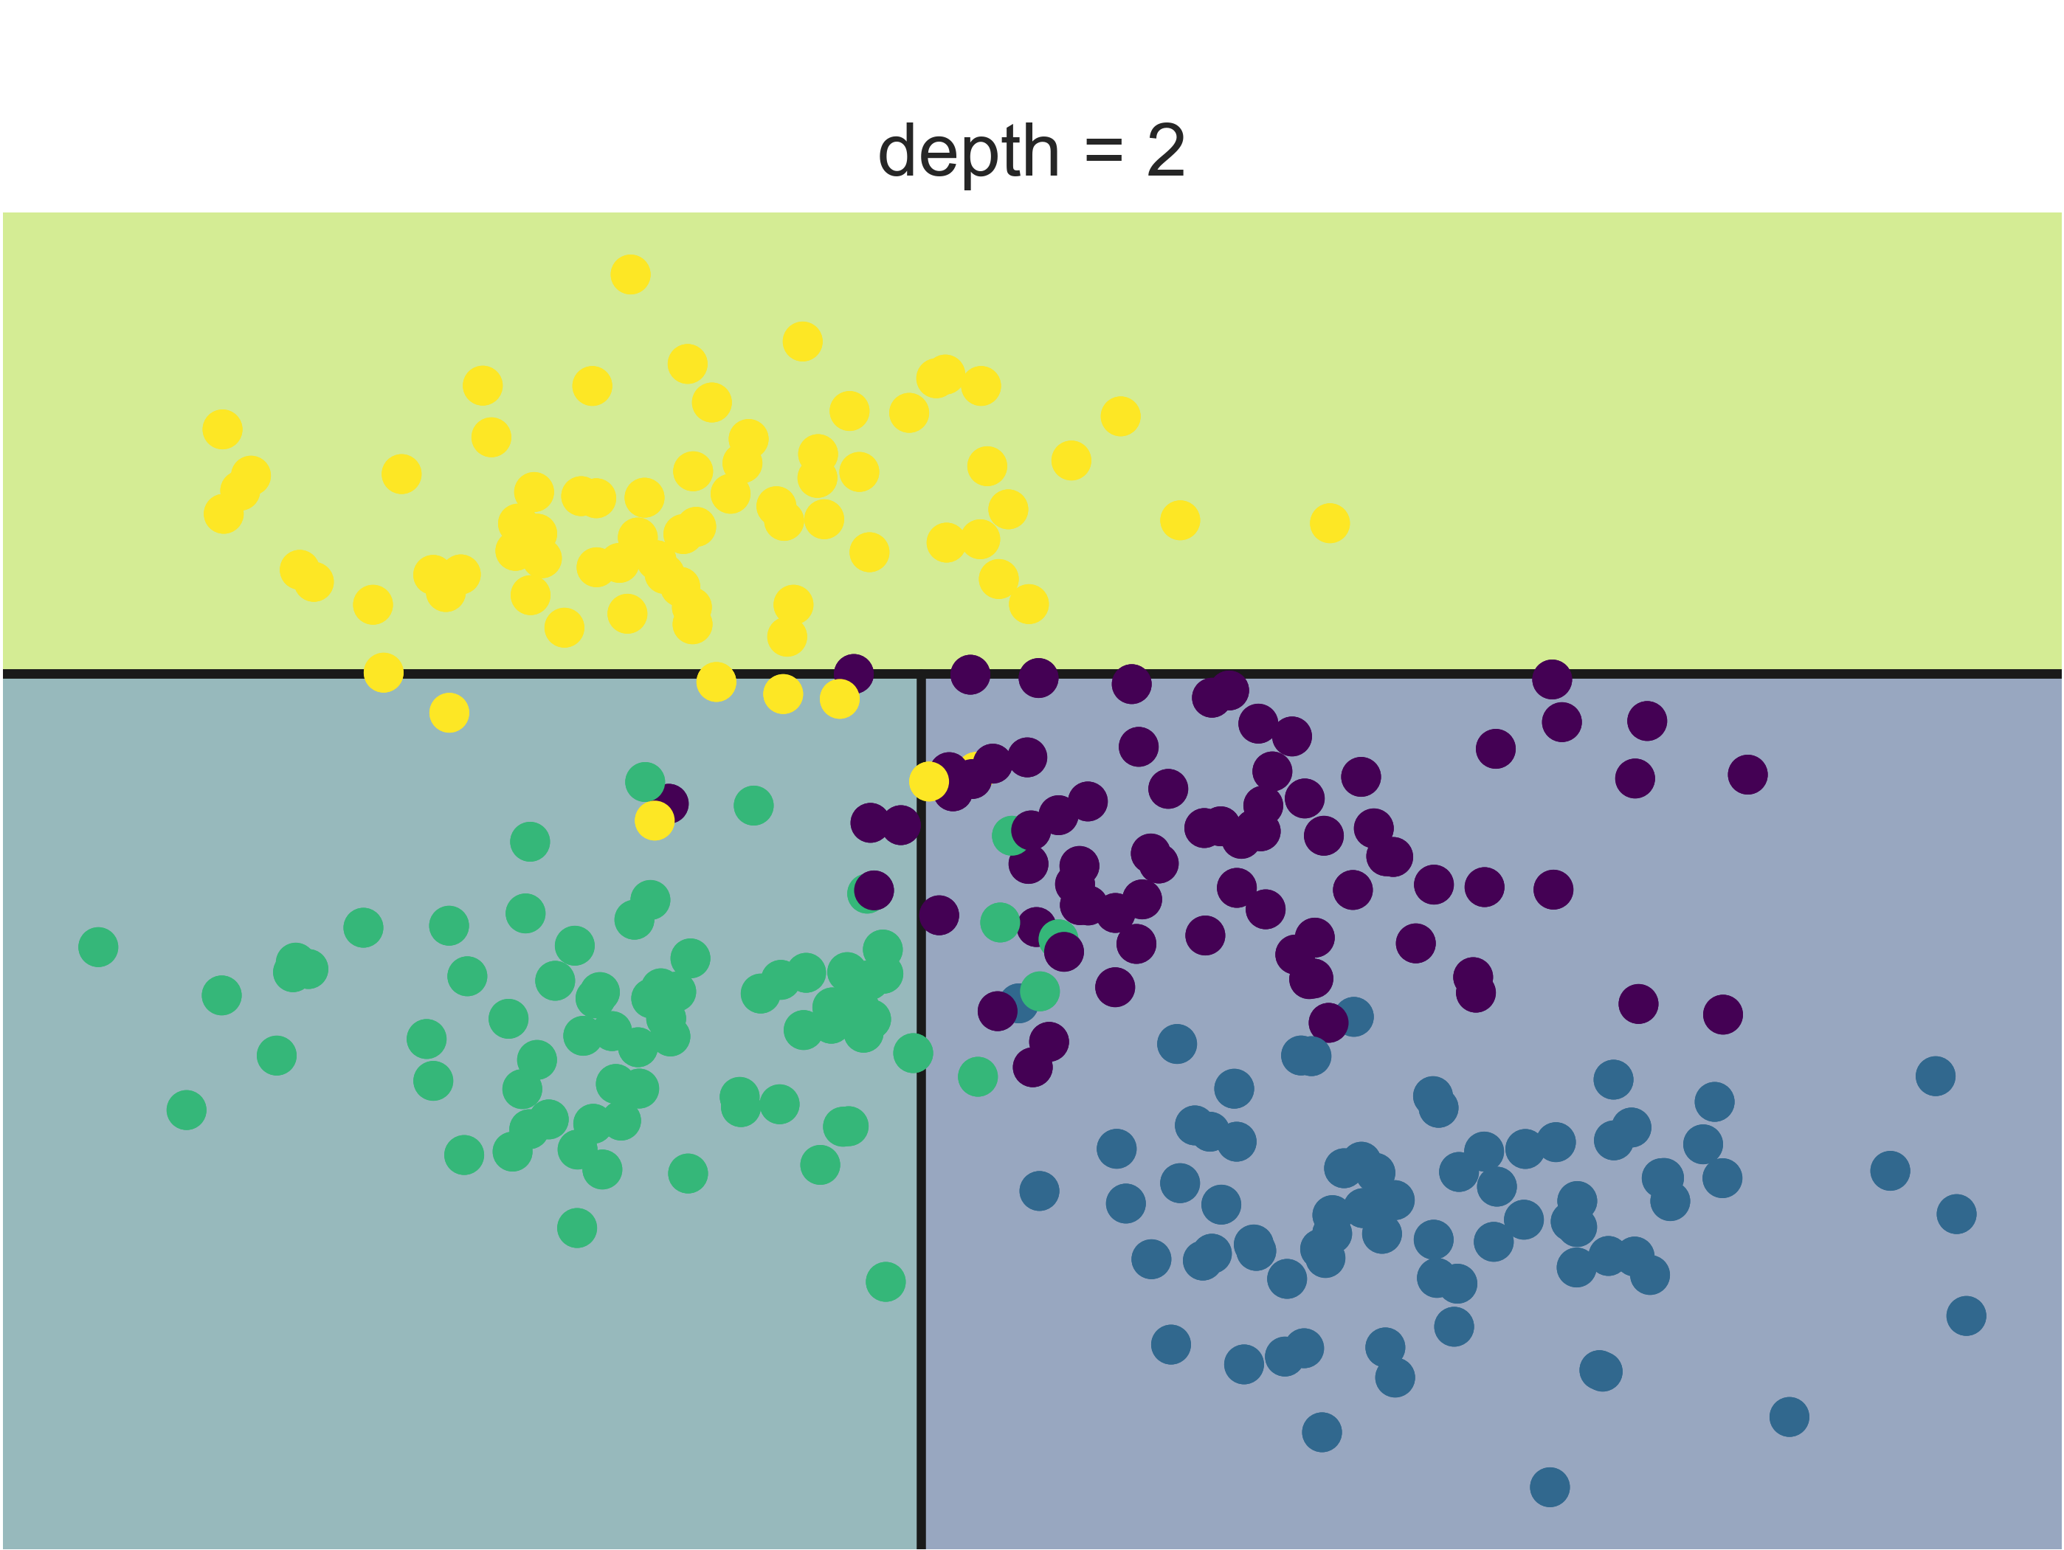
DTs example
$$y>y_{1}$$
$$x>x_{1}$$
$$y$$
yellow
$$y_{1}$$
Green
$$x_{1}$$
$$x$$

Slide 25
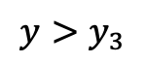
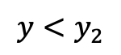
DTs example
$$y>y_{1}$$
$$x>x_{1}$$
$$y$$
yellow
$$y_{1}$$
$$y<y_{2}$$
$$y>y_{3}$$
$$x_{1}$$
$$x$$

Slide 26
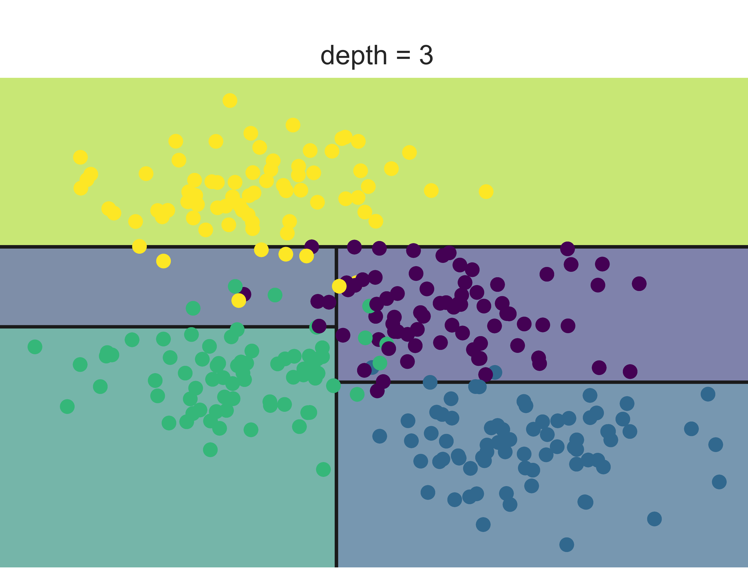
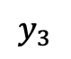
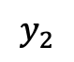
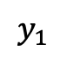
DTs example
$$y>y_{1}$$
$$x>x_{1}$$
$$y$$
yellow
$$y_{1}$$
$$y_{2}$$
$$y_{3}$$
$$y<y_{2}$$
$$y>y_{3}$$
$$x_{1}$$
$$x$$
yellow
Green
blue
purple

Slide 27
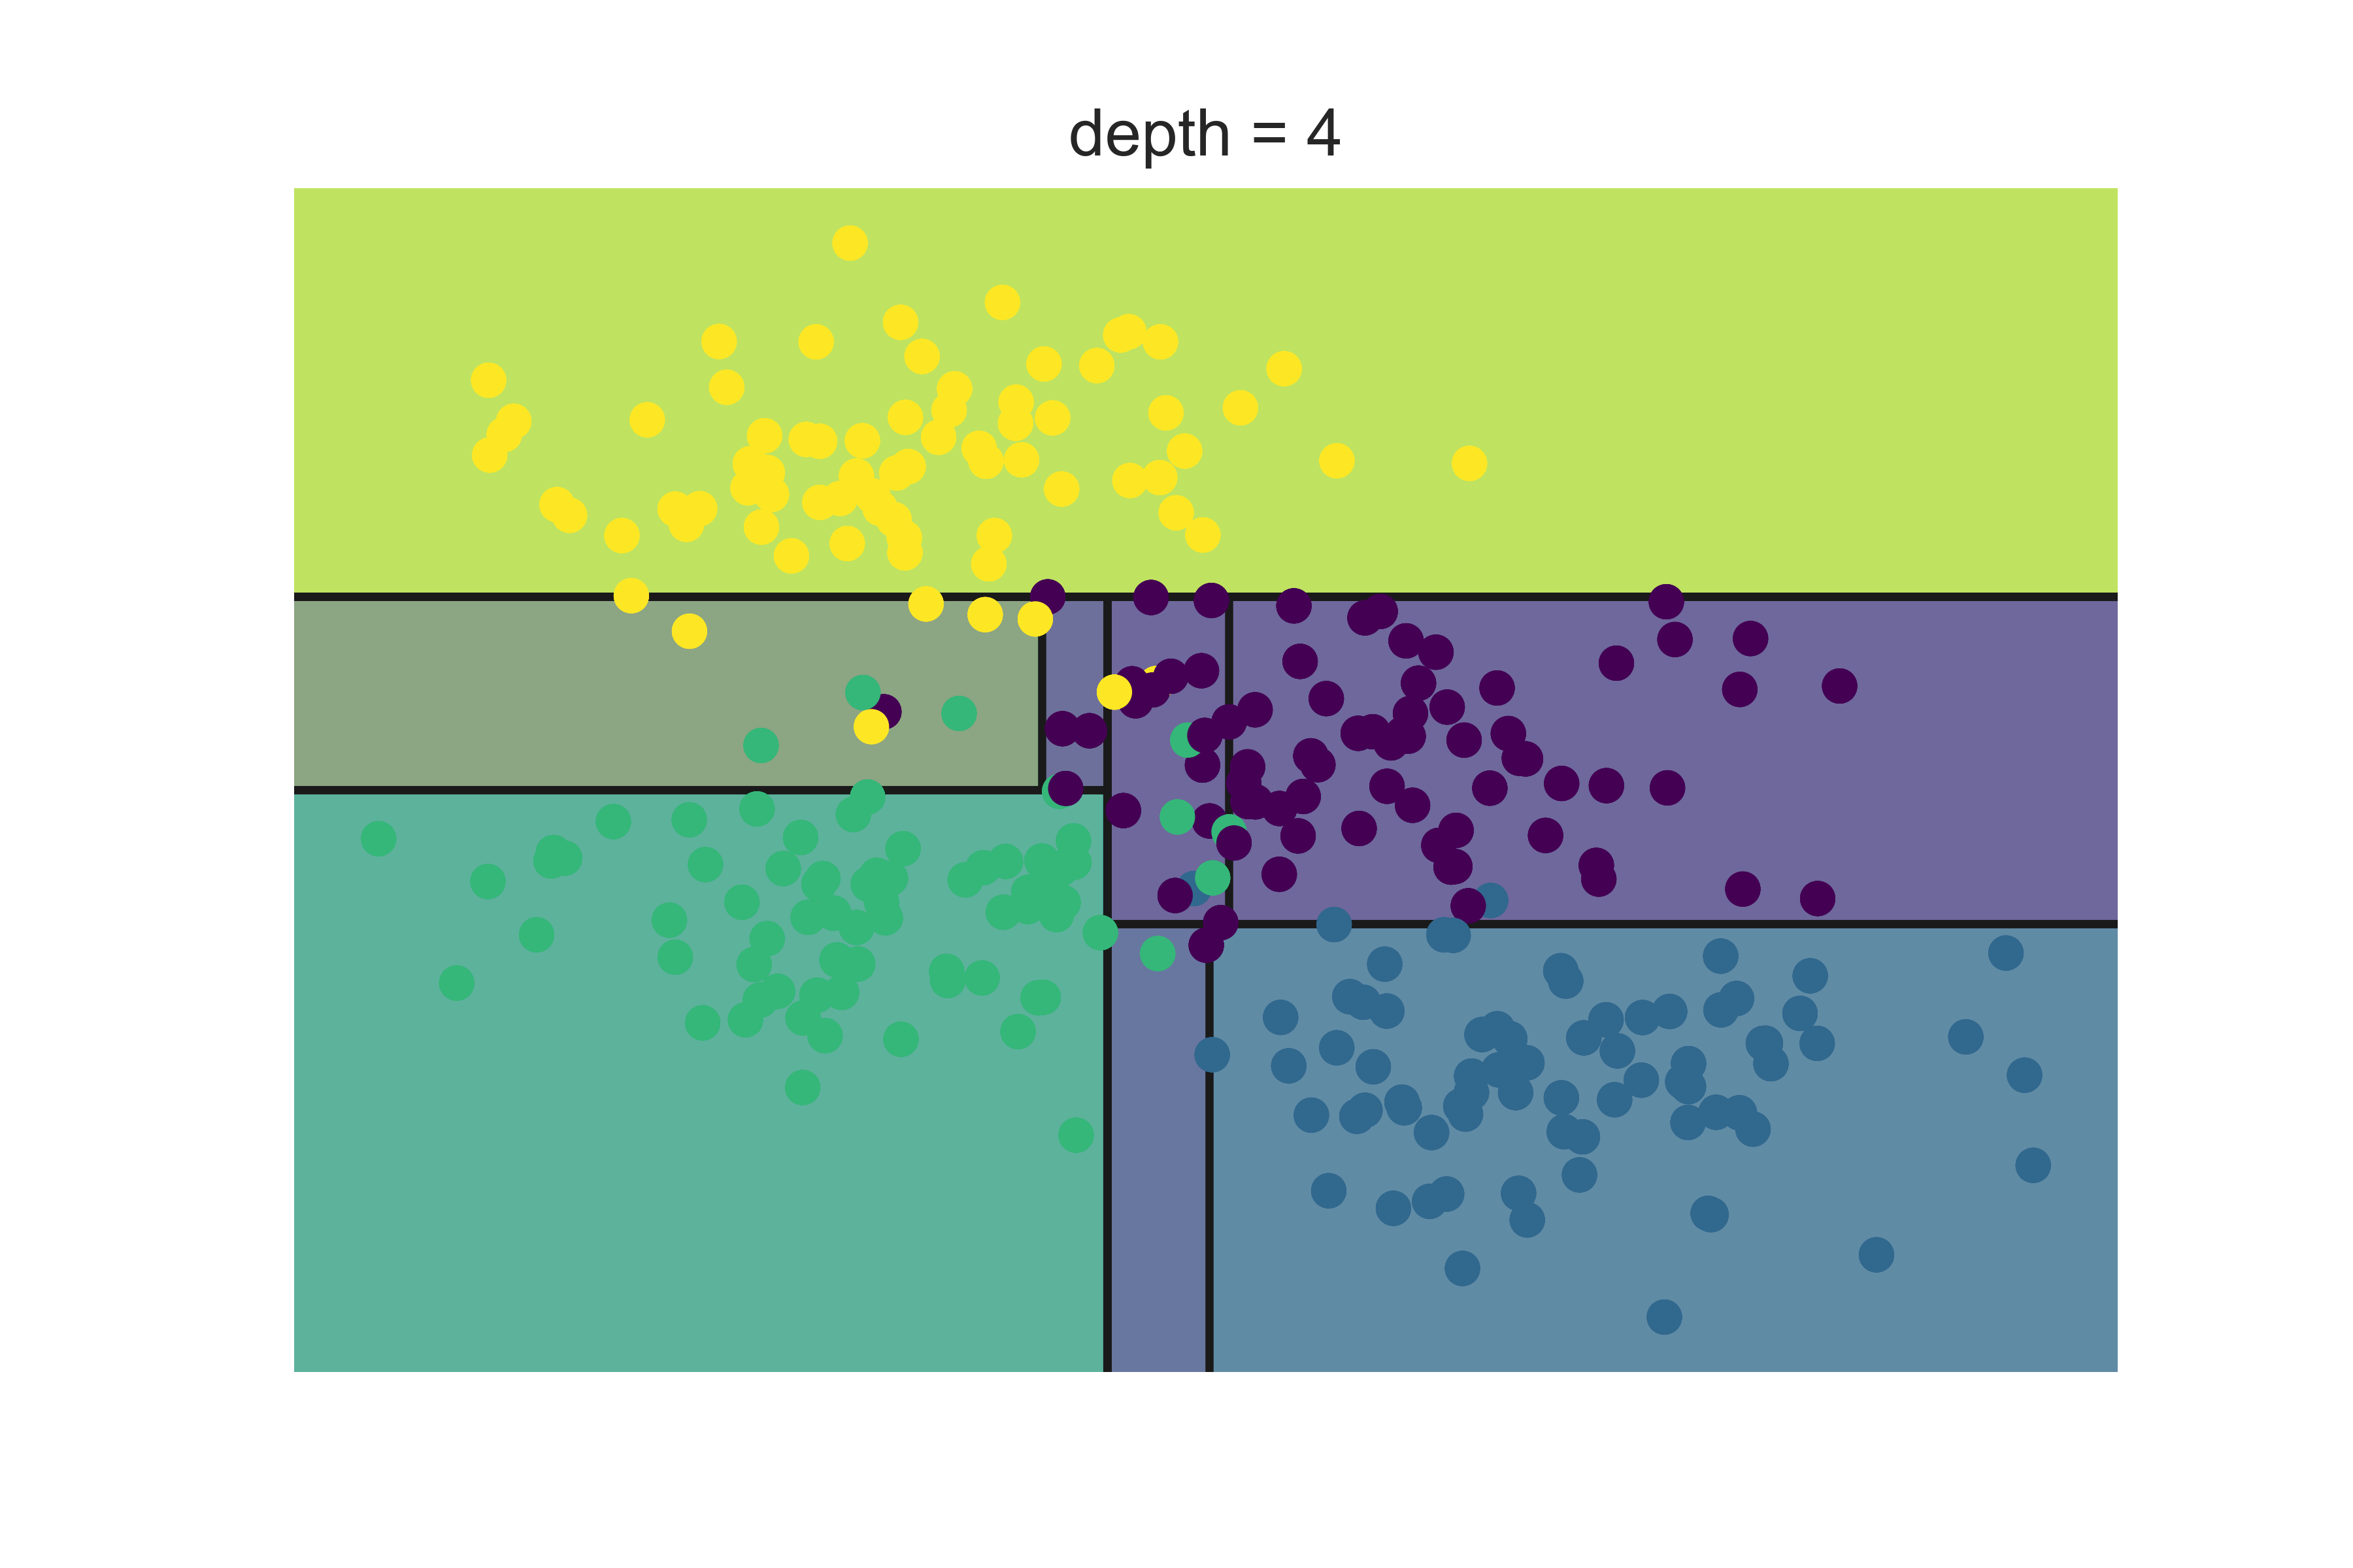
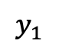
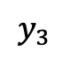
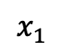
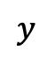
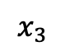
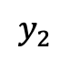
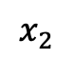
DTs example
The process is iterative..
When to stop?
$$y$$
$$y_{1}$$
$$y_{2}$$
$$y_{3}$$
$$x_{3}$$
$$x_{2}$$
$$x_{1}$$
$$x$$

Slide 28
DTs demo
Homes in San Francisco vs New York
Guess (classify) the location based on homes features
Elevation
Year built
Bathrooms
Bedrooms
Price
Prediction: San Francisco or New York

Slide 29
Building a DT
What is a good DT?
How to define the error?
How to split?
When to stop?

Slide 30
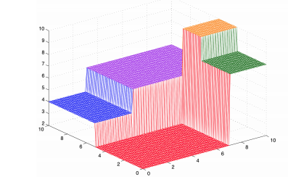
Building a DT
What is a good DT?
Homogenous space
Same elements in same region: low error

Slide 31
Building a DT
How to define the error?
Count misclassification
Measure of homogenous

Slide 32
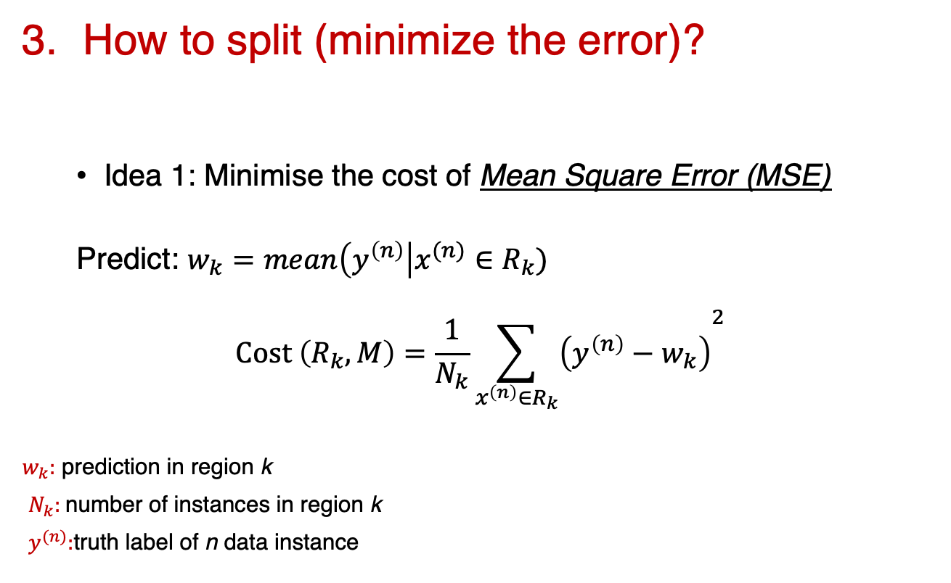
Building a DT
How to split (minimize the error)?
Idea 1: Minimise the cost of Mean Square Error (MSE)
Predict: $w_{k}=mean\left(y^{\left(n\right)}\right|x^{(n)}∈R_{k})$
$$Cost \left(R_{k}, M\right)=\frac{1}{N_{k}}{\sum_{x^{\left(n\right)}∈R_{k}}{\left(y^{\left(n\right)}−w_{k}\right)}}^{2}$$
$w_{k}:$ prediction in region k
$N_{k}:$number of instances in region k
$y^{(n)}:$truth label of n data instance

Slide 33
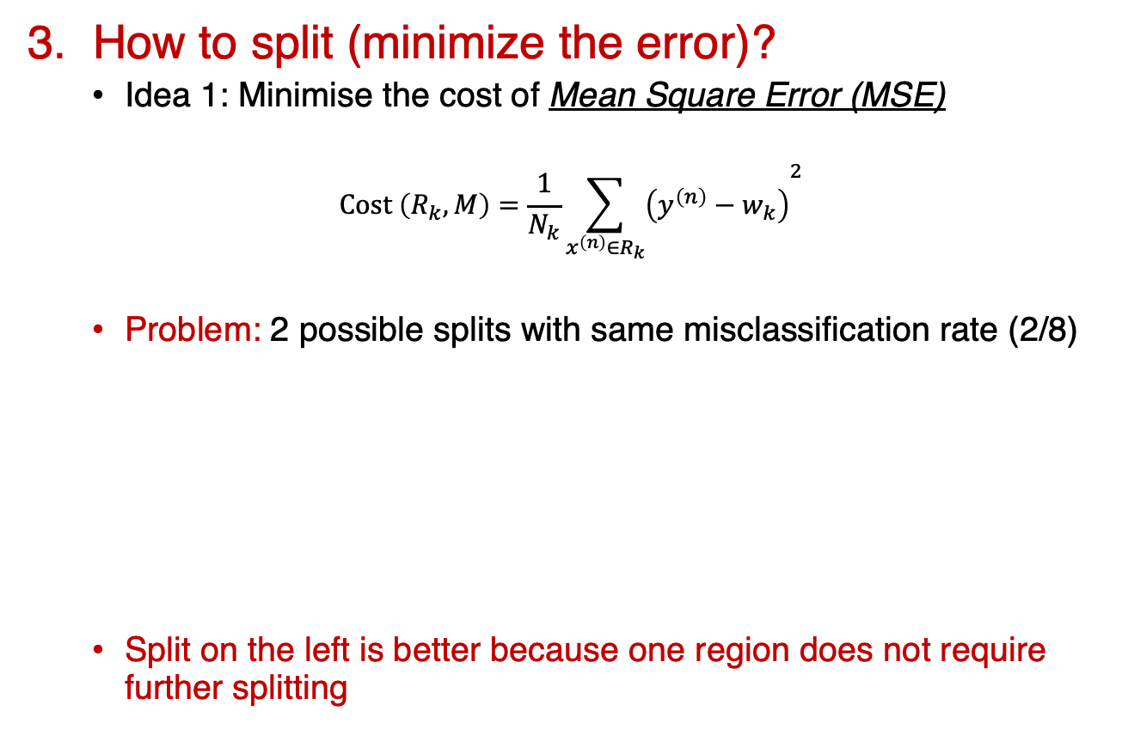
Building a DT
3. How to split (minimize the error)?
Idea 1: Minimise the cost of Mean Square Error (MSE)
$$Cost \left(R_{k}, M\right)=\frac{1}{N_{k}}{\sum_{x^{\left(n\right)}∈R_{k}}{\left(y^{\left(n\right)}−w_{k}\right)}}^{2}$$
Problem: 2 possible splits with same misclassification rate (2/8)
Split on the left is better because one region does not require further splitting
4 Blue
4 Yellow
4 Blue
4 Yellow
3 Blue
1 Yellow
1 Blue
3 Yellow
4 Blue
2 Yellow
2 Yellow

Slide 34
Building a DT
3. How to split (minimize the error)?
Idea 2: Minimise the entropy
Entropy: expected amount of information in observing a random variable (y)
4 Blue
4 Yellow
4 Blue
4 Yellow
3 Blue
1 Yellow
1 Blue
3 Yellow
4 Blue
2 Yellow
2 Yellow

Slide 35
Building a DT
When to stop?
DTs are prone to overfitting
Trial and error
Hyper-parameters tuning
Validation sets

Slide 36
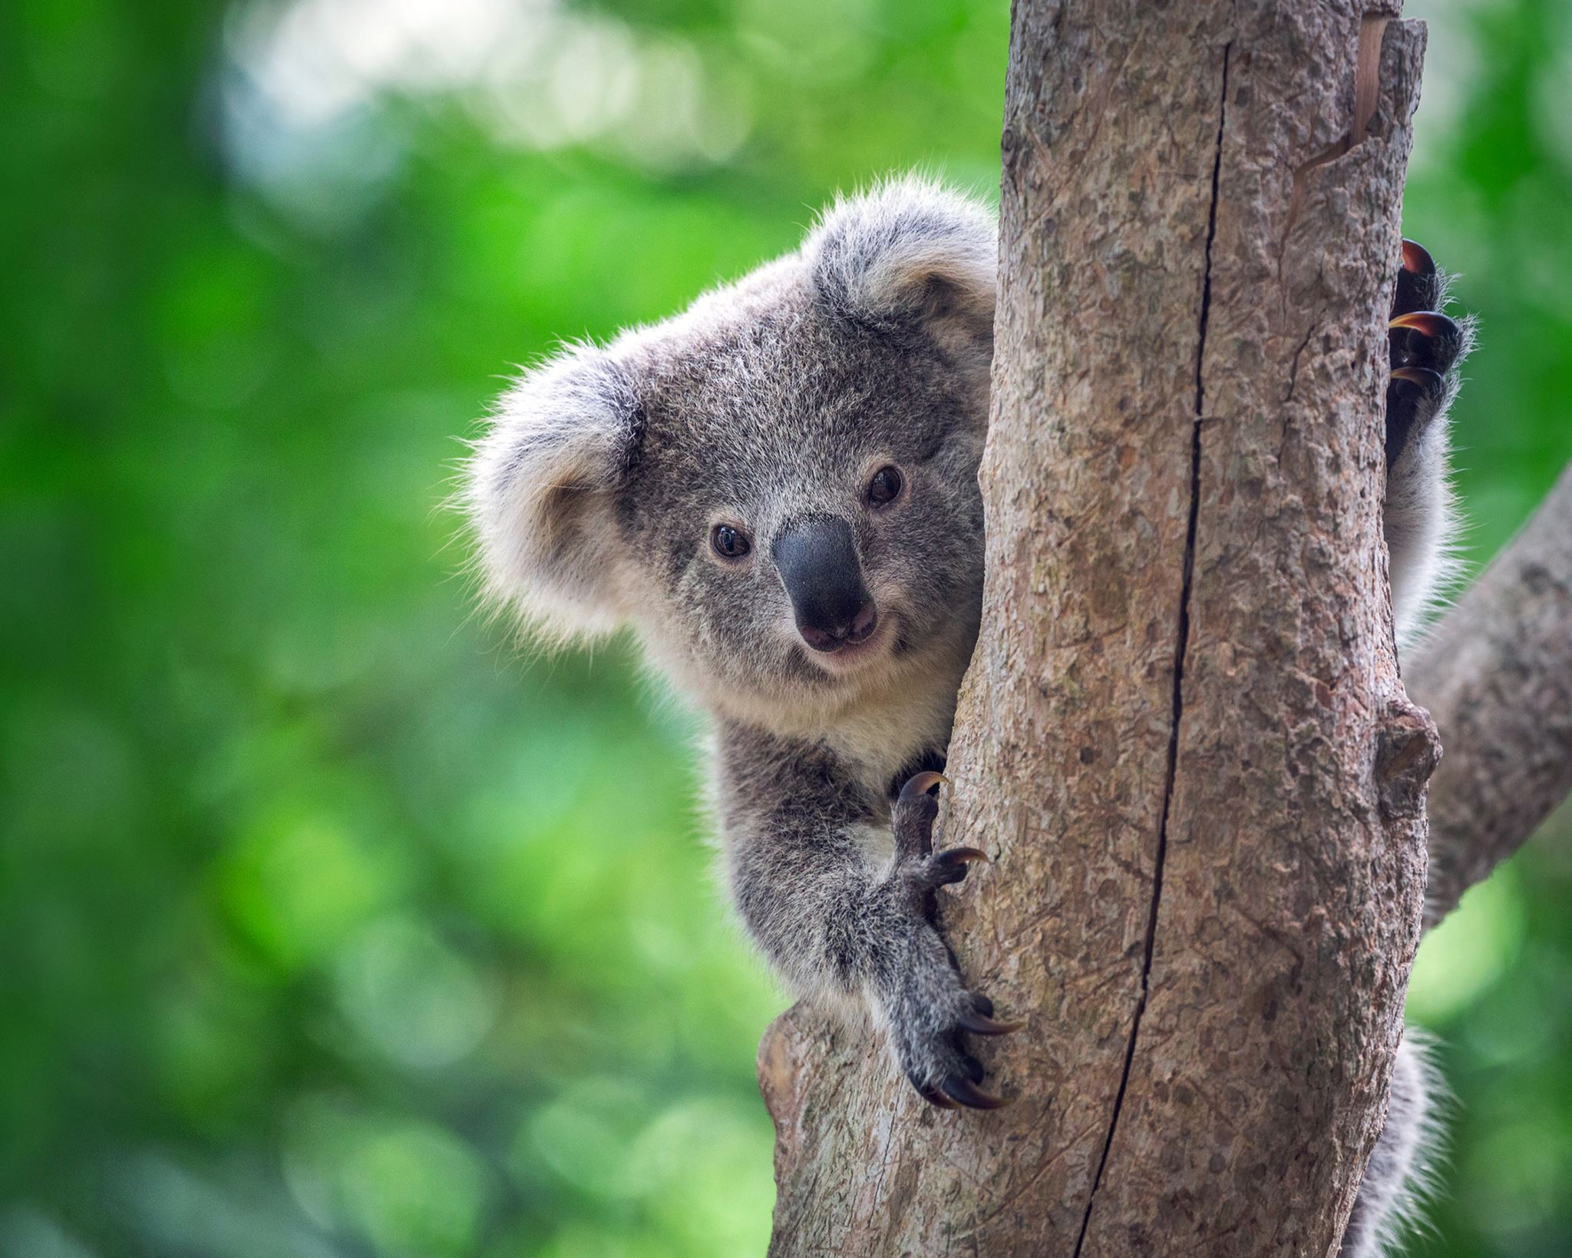
Break
15 minutes

Slide 37
DTs coding session
Notebook link
Colab / Jupyter notebook

Slide 38
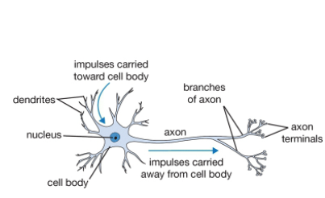
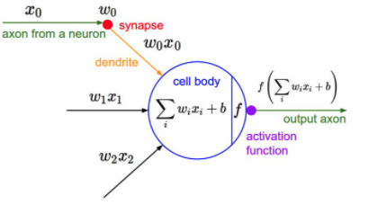
Artificial Neural Networks (ANNs)
It begins with a neuron
https://cs231n.github.io/neural-networks-1/

Slide 39
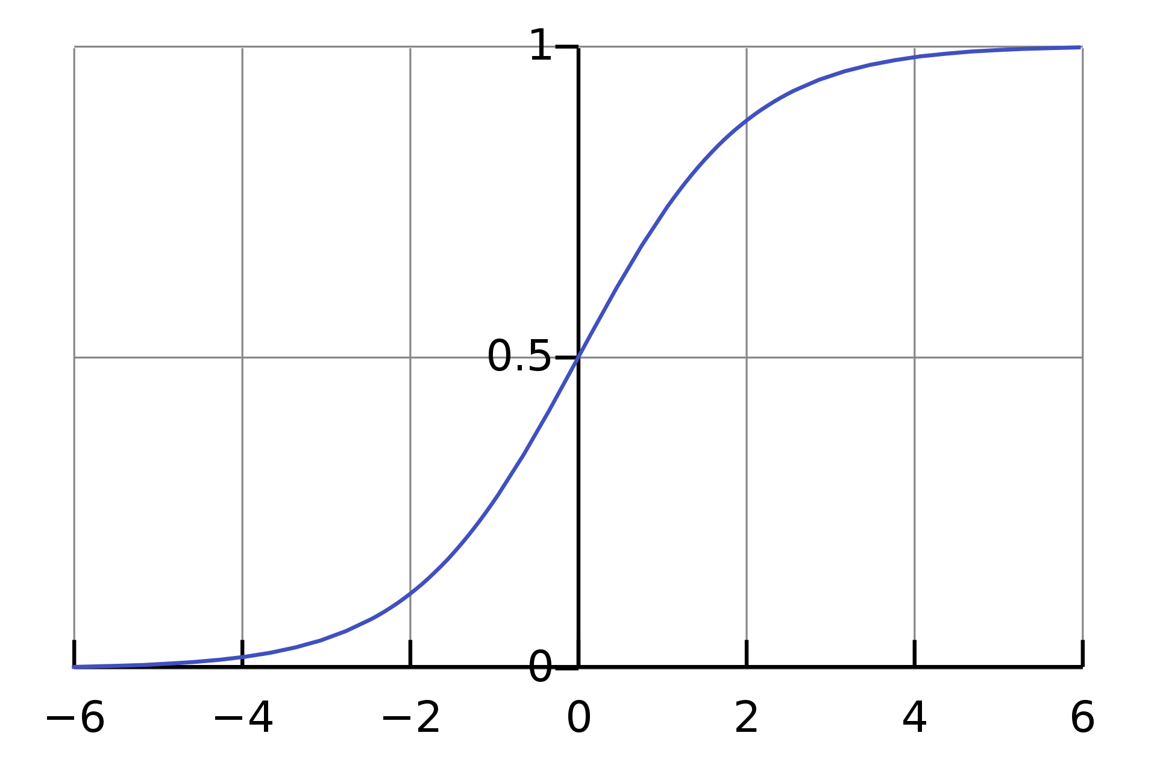
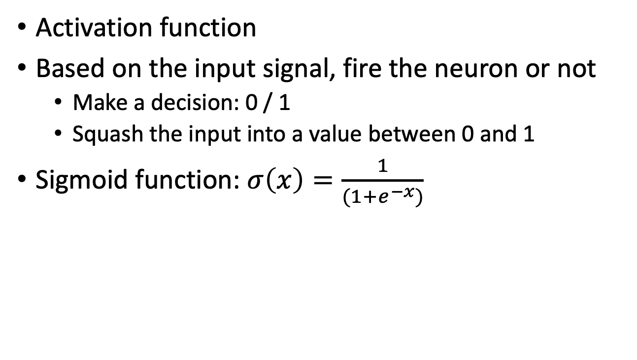
Building ANNs
Activation function
Based on the input signal, fire the neuron or not
Make a decision: 0 / 1
Squash the input into a value between 0 and 1
Sigmoid function: $σ\left(x\right)=\frac{1}{(1+e^{−x})}$

Slide 40
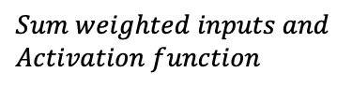







Building ANNs
$$x_{1}$$
$$w_{1}$$
$$Sum weighted inputs and \\ Activation function$$
$$x_{2}$$
$$w_{1}$$
$$y$$
$$w_{1}$$
$$x_{3}$$

Slide 41










Building ANNs
$$X=\left[2, 3, 1\right] \\ W_{0}=[0.4, 0.1, 0.3] \\ y_{true}=0$$
$$5$$
$$0.4$$
$$Sum weighted inputs and \\ Activation function$$
$$3$$
$$0. 1$$
$$y$$
$$0.3$$
$$\sum{w_{i}x_{i}=2.6}$$
$$σ\left(2.6\right)=1$$
$$y_{pred}=1$$
$$1$$

Slide 42




Building ANNs
$$X=\left[2, 3, 1\right] \\ W_{1}=[−0.4, 0.1, −0.3] \\ y_{true}=0$$
$$5$$
$$0.4$$
$$Sum weighted inputs and \\ Activation function$$
$$3$$
$$0. 1$$
$$y$$
$$0.3$$
$$\sum{w_{i}x_{i}=−2}$$
$$σ\left(−2\right)=0$$
$$y_{pred}=0$$
$$1$$

Slide 43

Building ANNs
How did we change the weights from $W_{0} to W_{1}$
This is the core of ANNs!
Iterative modification of the weights
Learning algorithms:
Gradient descent
Stochastic gradient descent
Adam
Feedforward and backward loops

Slide 44
ANNs architecture

Slide 45
ANNs demo
ANNs in action

Slide 46
ANNs coding session
Notebook link
Colab / Jupyter notebook

Slide 47

Important concepts
Categorical variables
One hot encoding
Convert categorical to numerical
Label
A
B
C
A
A
B
C
Label
1
2
3
1
1
2
3

Slide 48

Important concepts
You need to clean the data
Remove NaN and null values
Pandas: pd.dropna()

Slide 49

Performance metrics
Accuracy is only one metric
Definition: proportion of correct cases to all cases
$$Accuracy=\frac{True Positive+True Negative}{Tue Positive+True Negative+False Positive+False Negative}$$
Actual
 | Positive | Negative
Positive | True positive | False Positive
Negative | False Negative | True Negative
Predicted

Slide 50

Performance metrics
Cancer detection test with 99.7% accuracy (impressive?)
100,000 patients
1,000 Malignant (Positive)
99,000 Benign (Negative)
$Accuracy=\frac{850+98,820}{100,000}=99.7\%$
Question 1:
Of all patients that we predicted to have cancer, how many actually have Cancer?
$Precision=\frac{True positive}{True positive+False positive}=\frac{850}{850+180}=82.5\%$
Percentage of results which are relevant
Actual
 | Positive | Negative
Positive | 850 | 180
Negative | 150 | 98, 820
Total | 1,000 | 99,000
Predicted

Slide 51

Performance metrics
Cancer detection test with 99.7% accuracy (impressive?)
100,000 patients
1,000 Malignant (Positive)
99,000 Benign (Negative)
$Accuracy=\frac{850+98,820}{100,000}=99.7\%$
Question 2:
Of all patients that have Cancer, how many did we get right?
$Recall=\frac{True positive}{True positive+False negative}=\frac{850}{850+150}=85\%$
Percentage of total relevant results correctly classified
Actual
 | Positive | Negative
Positive | 850 | 180
Negative | 150 | 98, 820
Total | 1,000 | 99,000
Predicted

Slide 52

Performance metrics
Confusion matrix
For binary and multi-class classification
Correct elements are the diagonals
https://ml4a.github.io/demos/confusion_mnist/

Slide 53
Performance metrics
Accuracy is only one metric
Precision and recall
Confusion matrix
Critical for unbalanced datasets

Slide 54
Break
15 minutes

Slide 55
Coding competition
Work on Titanic dataset

Slide 56

Coding competition
Work on Titanic dataset
Work in groups
Compare DTs, ANNs, and SVMs
30 minutes
Go!

Slide 57
Coding competition
Work on Titanic dataset
Work in groups
Compare DTs and ANNs
Apply performance metrics
Hyper-parameters tuning?
Bonus: Apply Support Vector Machines (SVM)?
30 minutes
Go Go Go!

Slide 58
Deep Learning
Evolution of ML
Exploits abundance of data
Automatic extraction of features

Slide 59
Deep Learning
Convolutional Neural Networks

Slide 60
Deep Learning
Recurrent Neural Networks

Slide 61
Next steps
Introductory books:
The Elements of Statistical Learning
Information Theory, Inference, and Learning Algorithms
Understanding Machine Learning: From Theory to Algorithms
Dive into Deep Learning
Online resources
Online courses: EdX, Coursera, ...
Datasets and competitions: Kaggle, IEEEDataPort, …
Online articles: Towards Data Science, Medium, …
Google is great ☺

Slide 62
References
http://cs231n.stanford.edu/
https://www.siamak.page/courses/COMP551F20/index.html
https://homes.cs.washington.edu/~pedrod/papers/cacm12.pdf

Slide 63
Questions?

Slide 64

Questions?

Slide 65
Questions?
Github repo
https://github.com/abdelrahman-ayad/MiCM-introML-W21
Contact info:
abdelrahman.ayad@mcgill.ca

